Slide 1
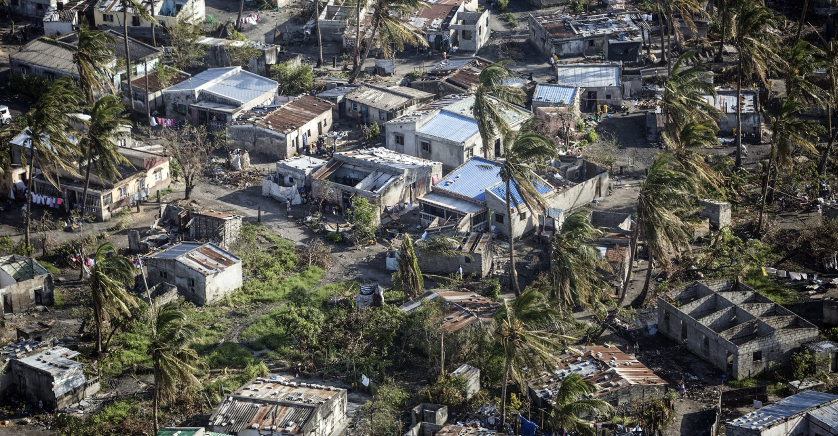
Comparative Impact Analysis of Cyclone Ana in the Mozambique Channel Using Satellite Data - Independent Research Project Emma Schoenmakers
Supervised by Dr. Minerva Singh & Dr. Adriana Paluszny
Department of Earth Science & Engineering
September 2022

Slide 2
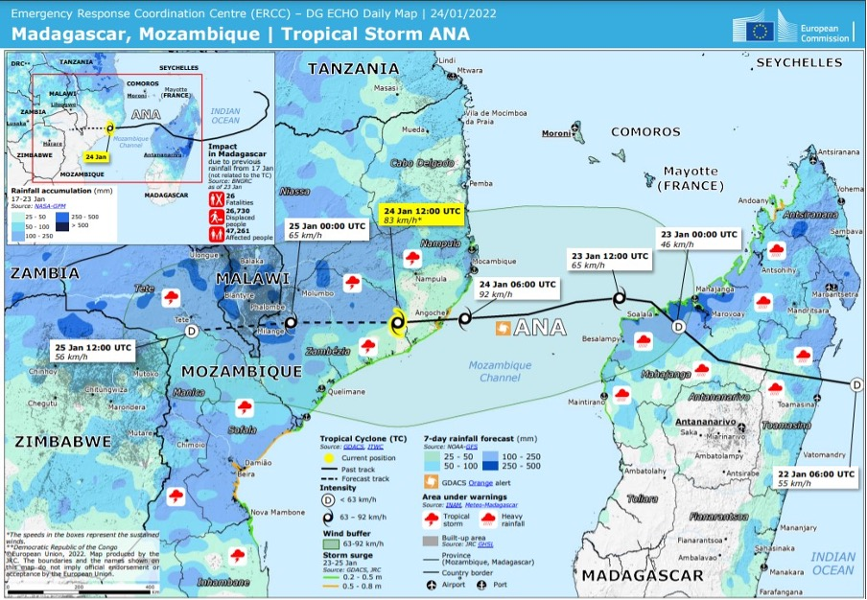
Background
Tropical cyclone Ana occurred between the 20th of January-25th January 2022 over the Mozambique Channel
Cyclone season in the Mozambique Channel: November and March in Madagascar & November to April in Mozambique
960,000 People Affected
5 Extreme Cyclone Events
2021-2022 Cyclone Season in Numbers, Mozambique Channel

Slide 3
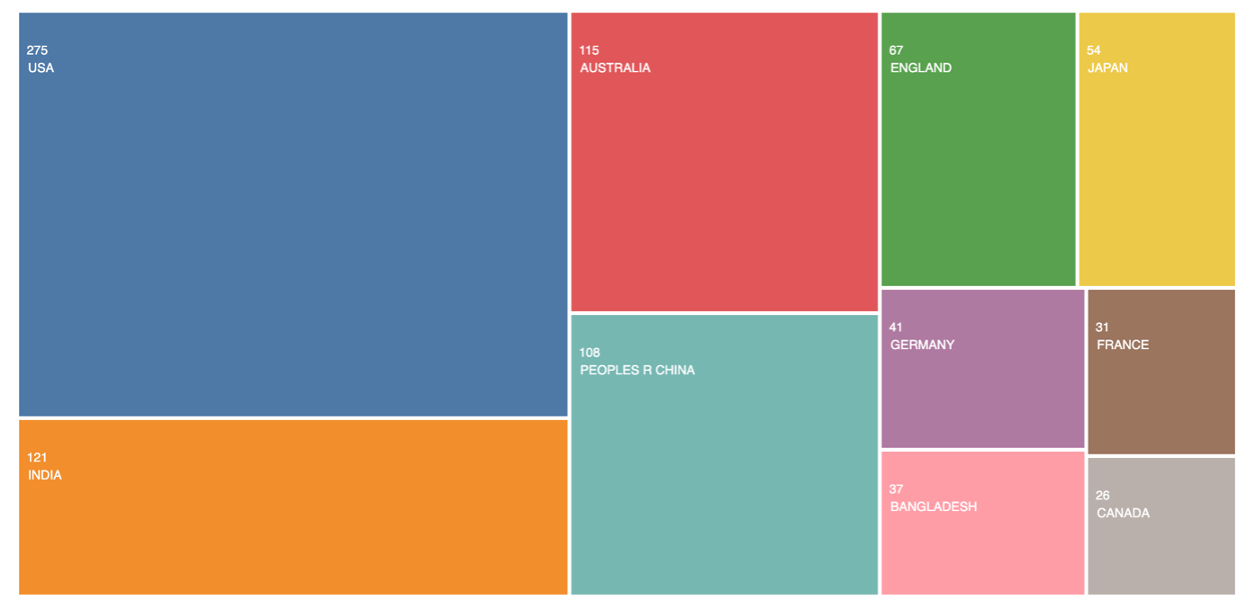
Knowledge Gap & Objectives
35% of cyclone impact studies based in the USA
0.6% of studies based in Mozambique Channel
Objectives:
Are there differences in the climatic and anthropogenic impacts after tropical cyclones in coastal Mozambique and Madagascar?
Specifically, were mangrove forests degraded after the tropical cyclone?
Were there regional differences in the degradation extent and pattern? For example, do areas in the vicinity of the mangrove hit by the tropical cyclone fare better than non-mangrove areas?
Publications Related to ‘Impact assessment’ and ‘cyclone’ Keywords by Country of Case Study (Web of Science).

Slide 4
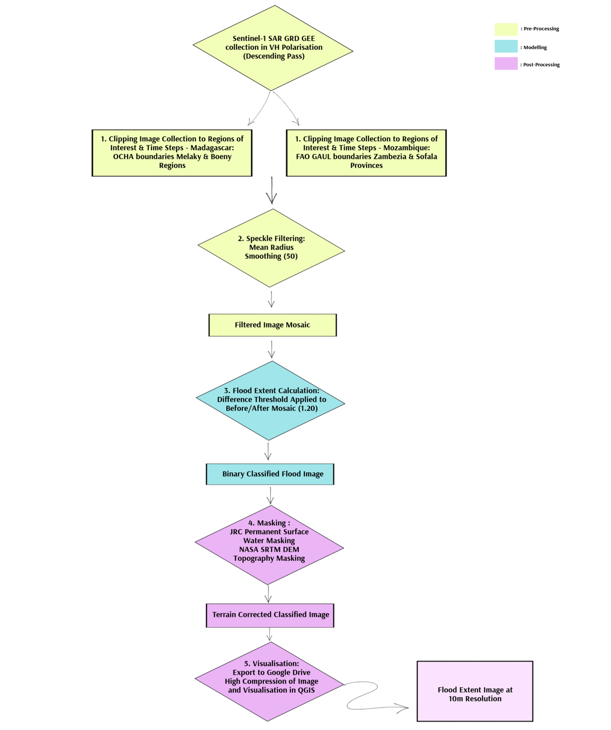
Methodology
Regions of Interests:
Boeny, Melaky – Madagascar
Sofala, Zambezia – Mozambique
Flood Model:
Adapted Methodology from UN-SPIDER Recommended Practice using Sentinel-1 SAR Data in Google Earth Engine and Python
Impact Assessment Model:
Intersections of World Population Data: Population Density and Exposed Population
ESA World Cover Data: Affected Land Cover Types eg. Urban Areas
Sentinel-2 Data: Mangrove Degradation

Slide 5
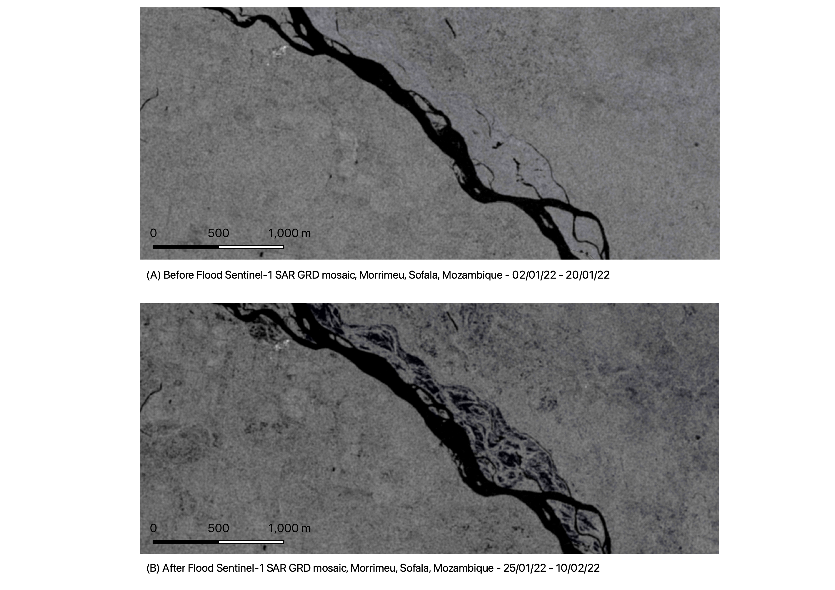
Results
Before and After radar Images show clear differences in water extent
Significant flooding around the Zambezi River, Mozambique
Flooding in croplands on the east flank of the river

Slide 6
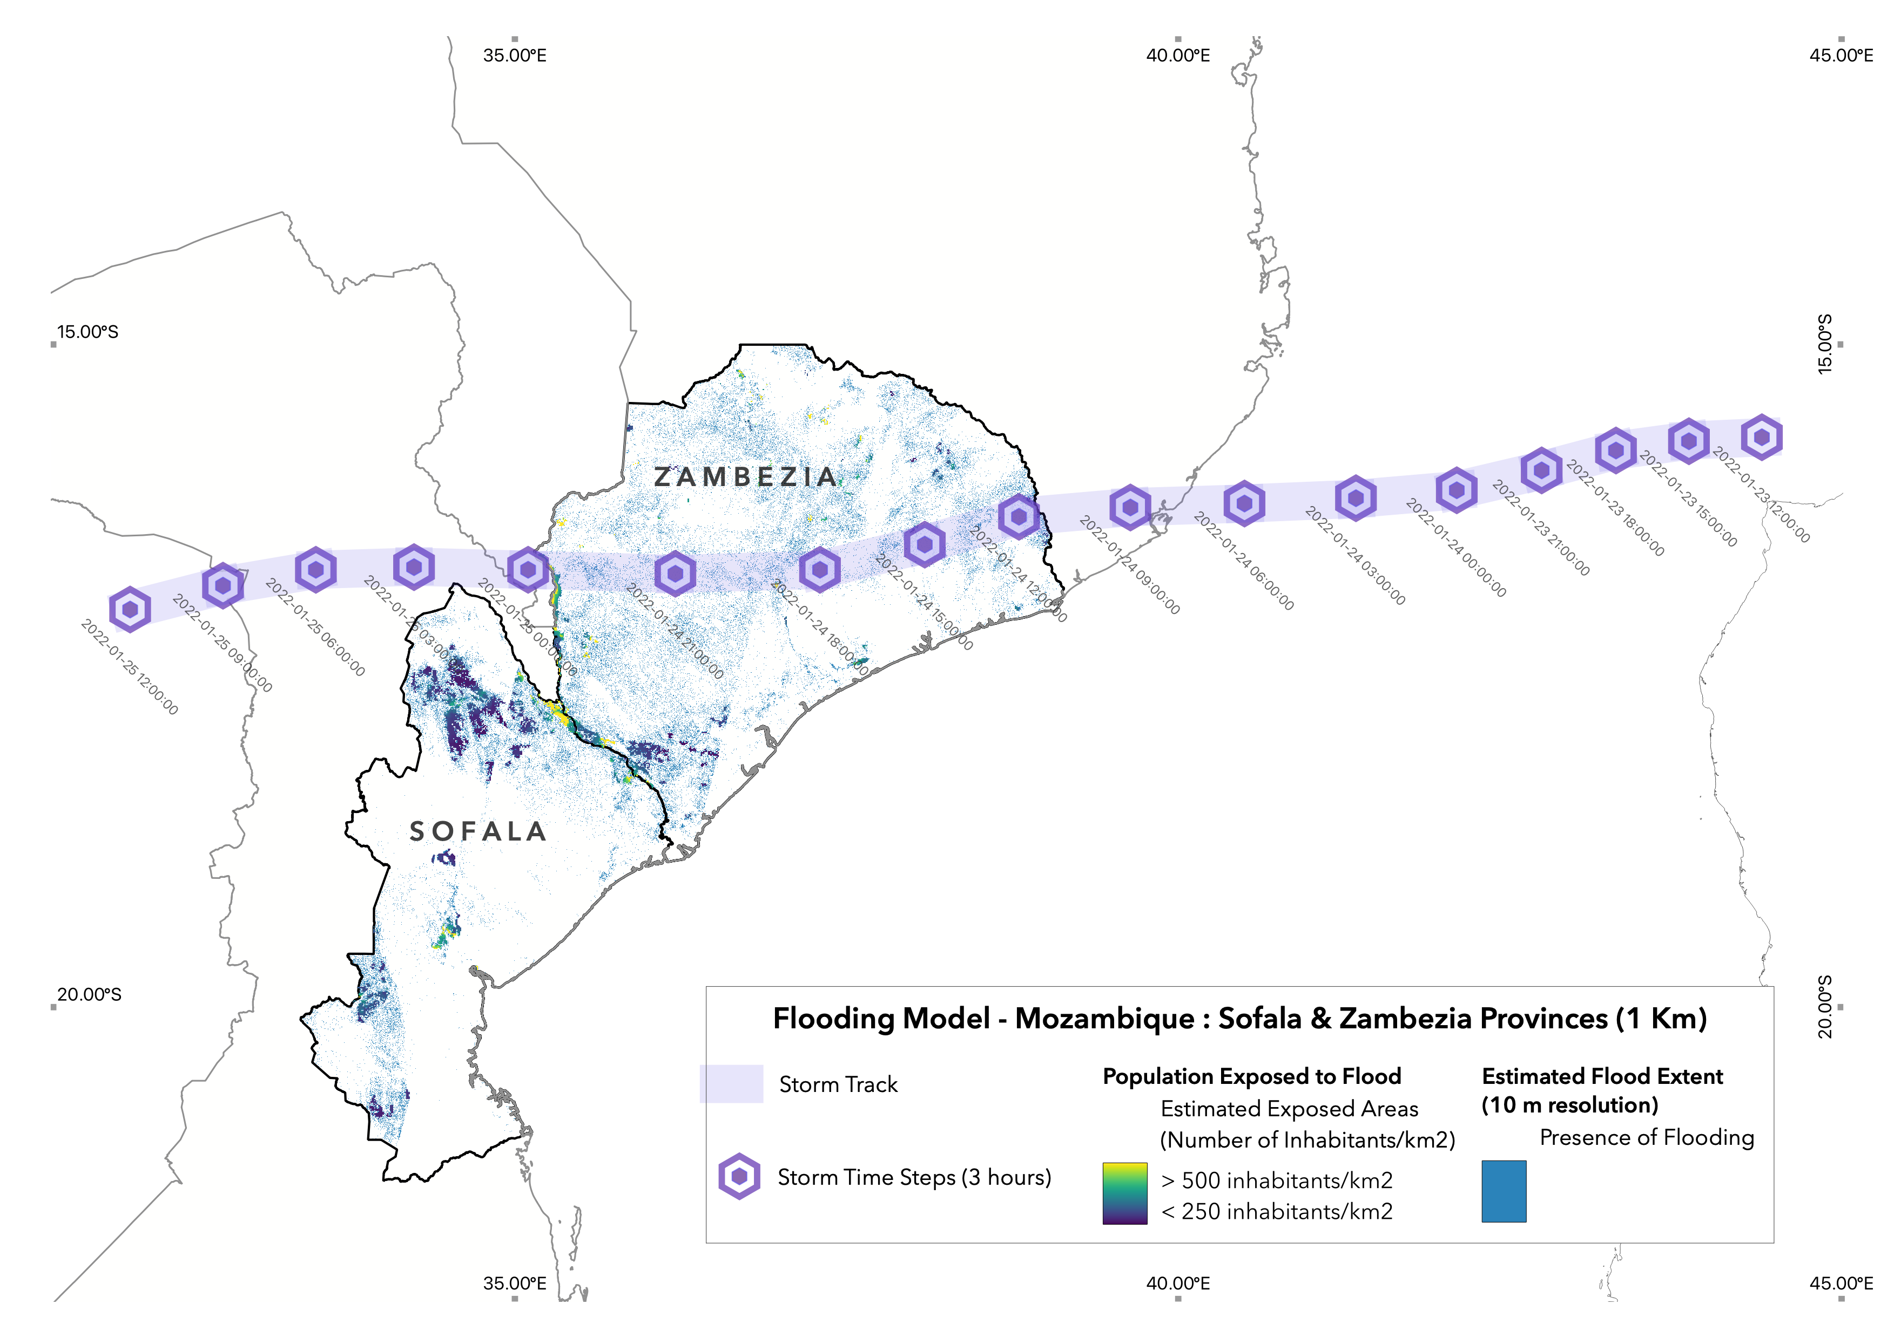
Areas with highest number of people affected per km² located in areas around the Zambezi River, in the Sofala province, Mozambique.
Especially in riverside cities such as Caia and Marromeu, Sofala (light yellow)

Slide 7
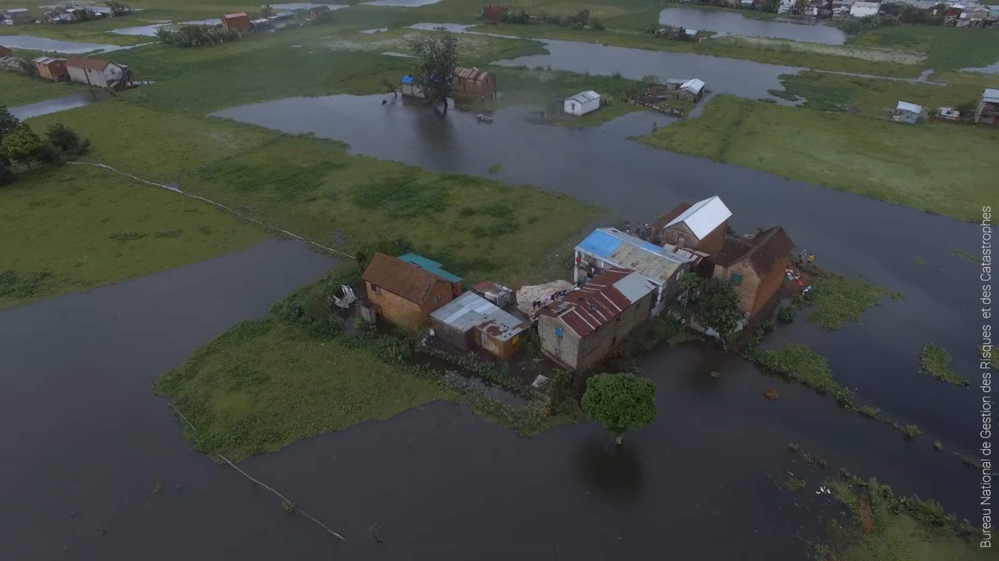
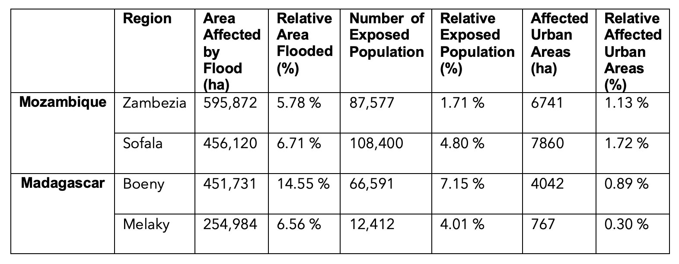
Summary Table of Comparative Flood Model

Slide 8
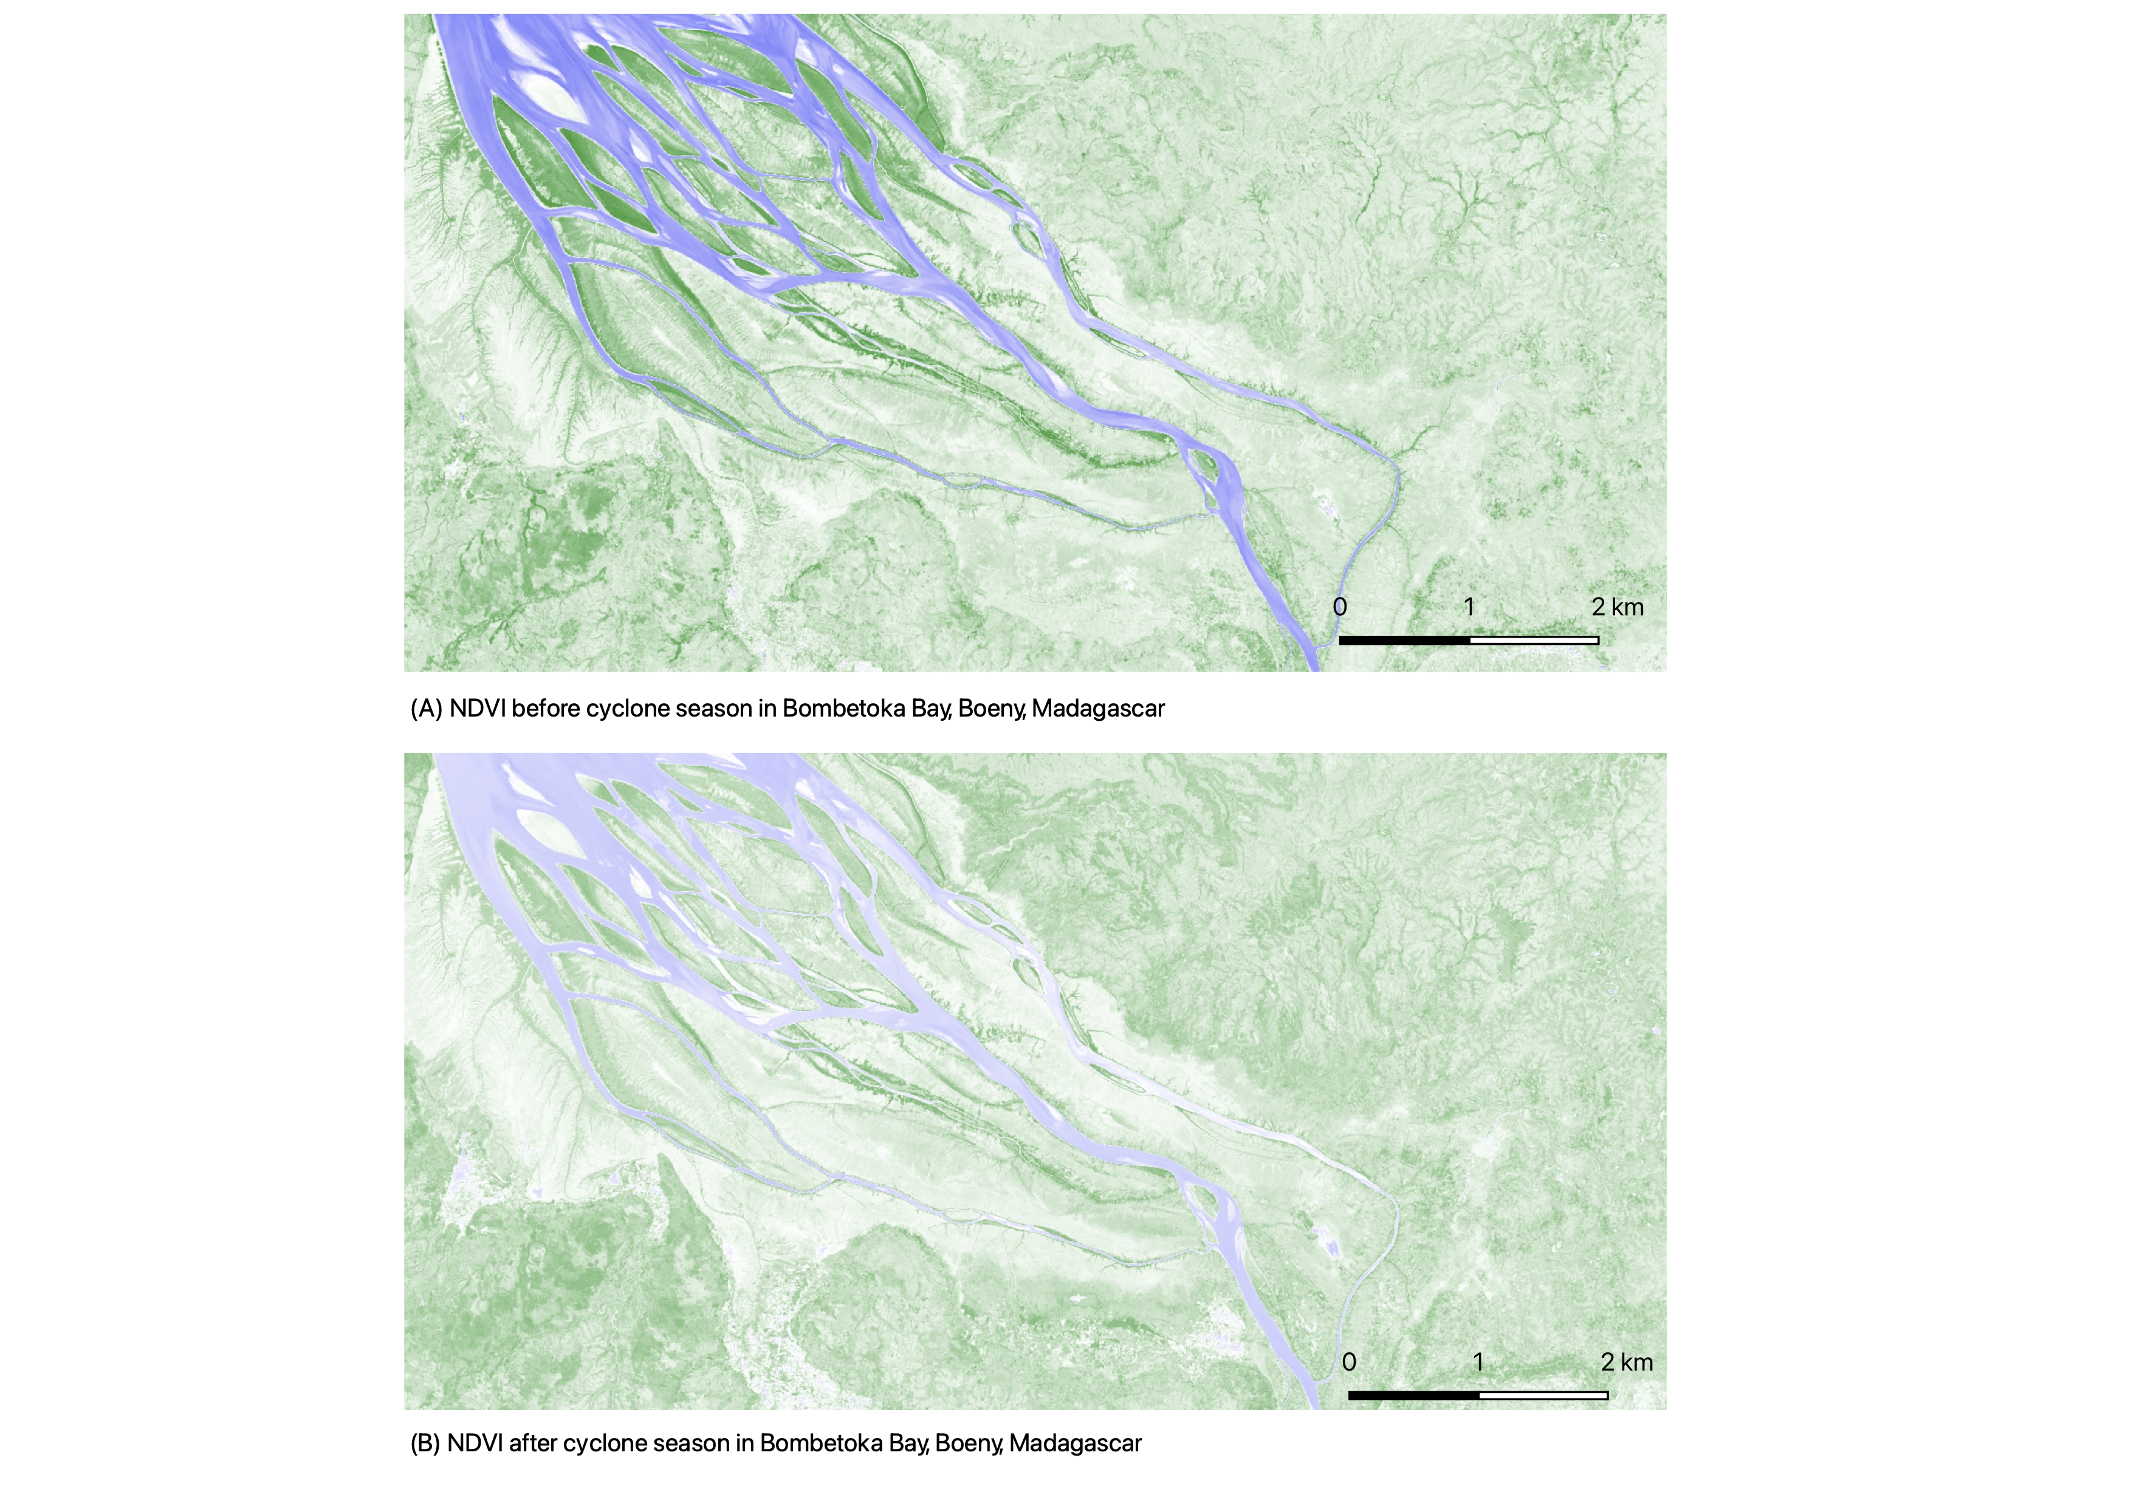
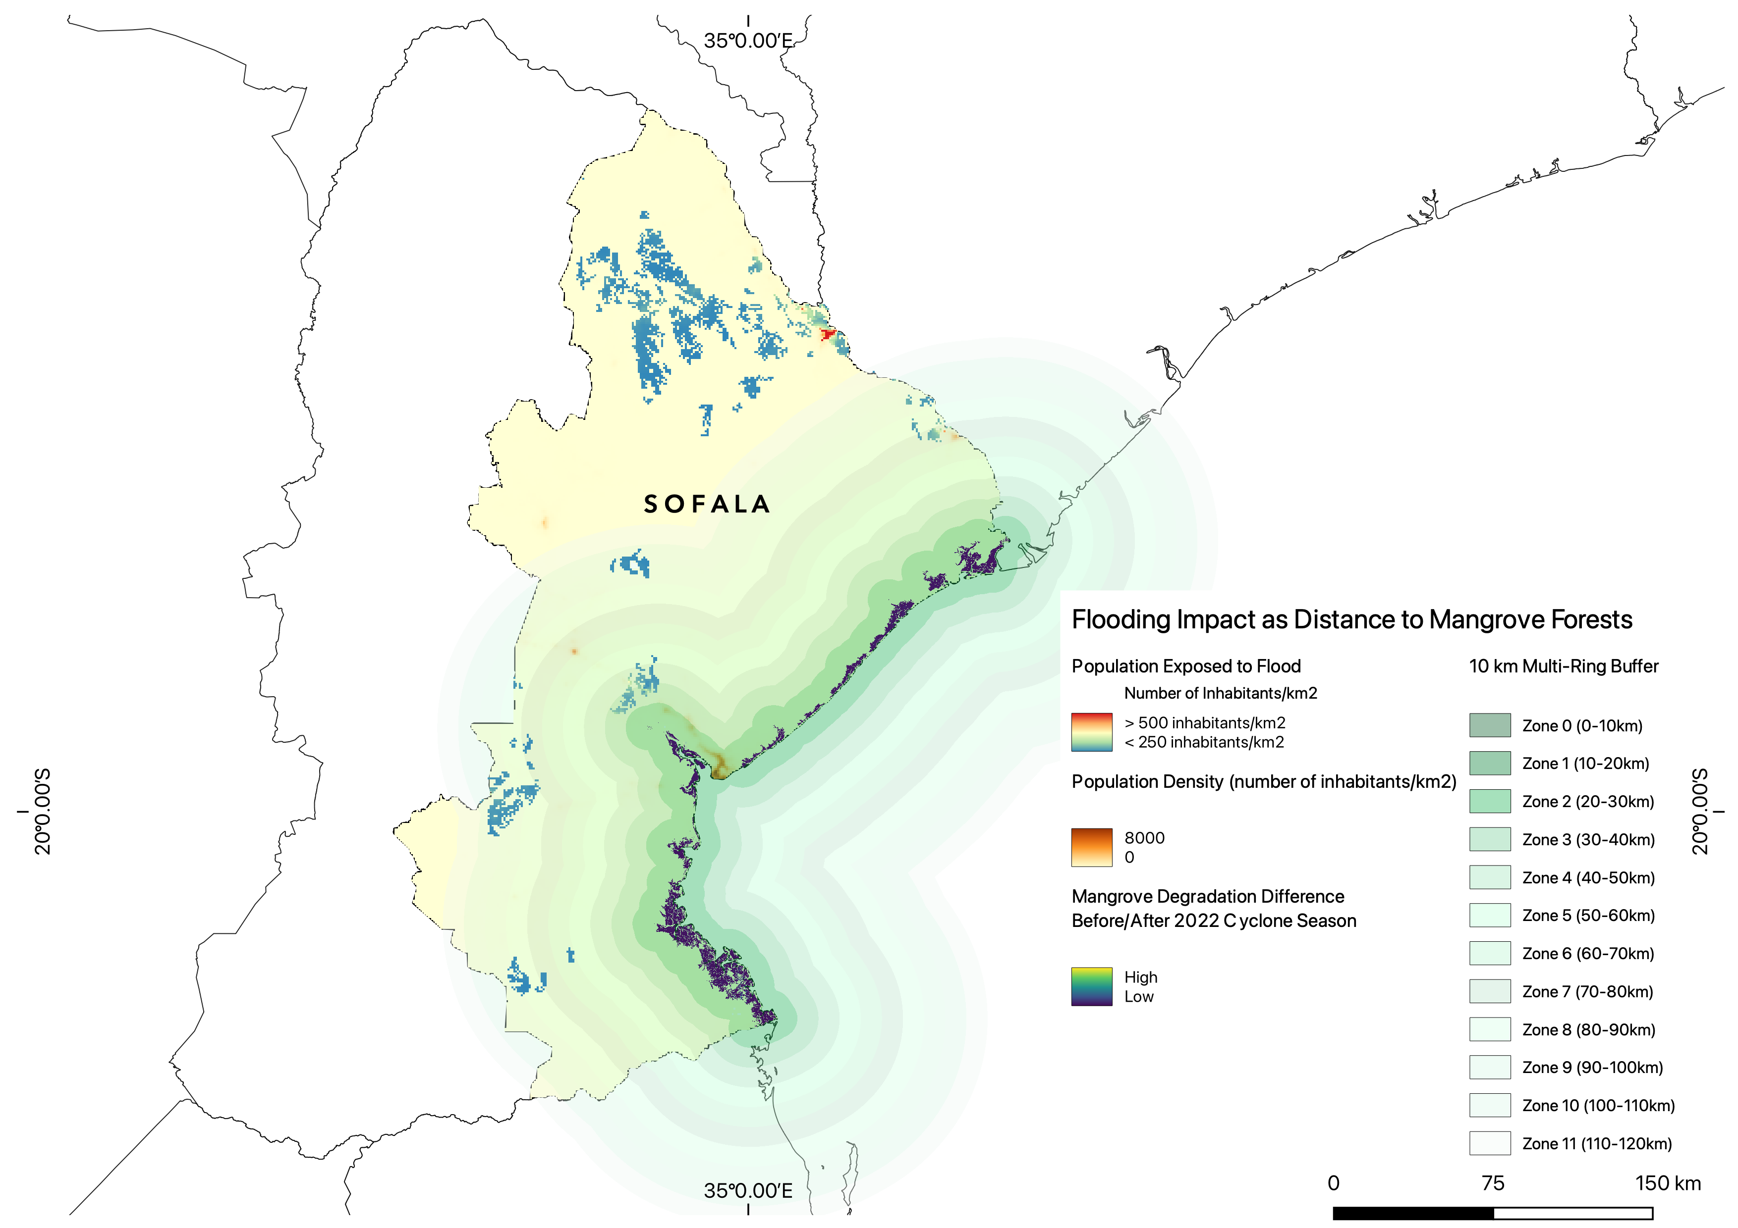

Slide 9
Discussion & Limitations
5-15% of the study areas flooded – less damaging cyclone than cyclone Idai in 2019 (Mozambique)
Our numbers agree with ReliefWeb numbers :185,429 people estimated to have been affected by cyclone Ana in Mozambique, concurs with our model’s prediction of 195,977 affected people.
Majority of flooding in Mozambique along the Zambezi River, easily flooded croplands and low elevation areas – threat to food security.
To a lesser extent, majority of flooding in Madagascar mostly in croplands, barren areas and along the Betsiboka River
Mangroves in Mozambique were found to be unaffected by the cyclone season – low degradation and potential recovery from previously tough cyclone seasons in 2019, 2020?
Similar pattern in Madagascar, despite more differences at fine scale especially in mangroves patches close to barren areas – increased vulnerability
Mangroves found to be successful at protected vulnerable coastal populations from cyclone impacts in Mozambique Channel
NDVI Cloud Cover
Lack of Local Expertise in Mozambique
Author Bias to Land Cover
Recent Immigration/Emigration Trends
Unavailability of Malaria Data
Low Number of Studies For Data Validation
IRP Study Limitations

Slide 10
Conclusion
Study successfully mapped flood extent and impacts in Mozambique Channel after Cyclone Ana in January 2022
Found generally undegraded mangrove ecosystems in Madagascar and Mozambique
Offers an accessible, reproduceable method for rapid cyclone impact assessment.
Further Applications
Integrative Impact Assessment for Global South, particularly to underrepresented South Indian Ocean island nations.
Beyond humanitarian approach : potential for rapid assessments of causes and buffers to cyclone damage.
Can be associated to studies (Cabral et al., 2017) looking at Exposure Index (EI) to discuss vulnerability.
Further studies, depending on data availability, should integrate gender and malaria data in post-cyclone impact assessments.

